Slide 1

Diagram
Animation and
Visualization
Environment
Group 2

Slide 2
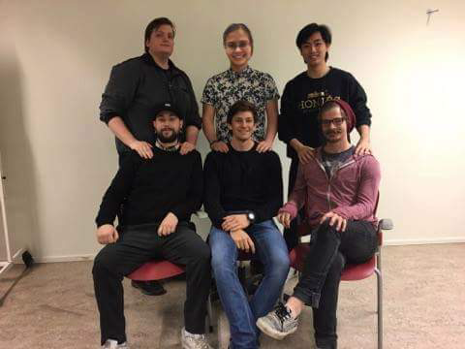
ABOUT US
ELAINE QVARNSTRÖM
ERIK LAURIN
SHAUN MCMURRAY
BOYAN DAI
JOACIM EBERLÉN
JUSTINAS STIRBYS

Slide 3
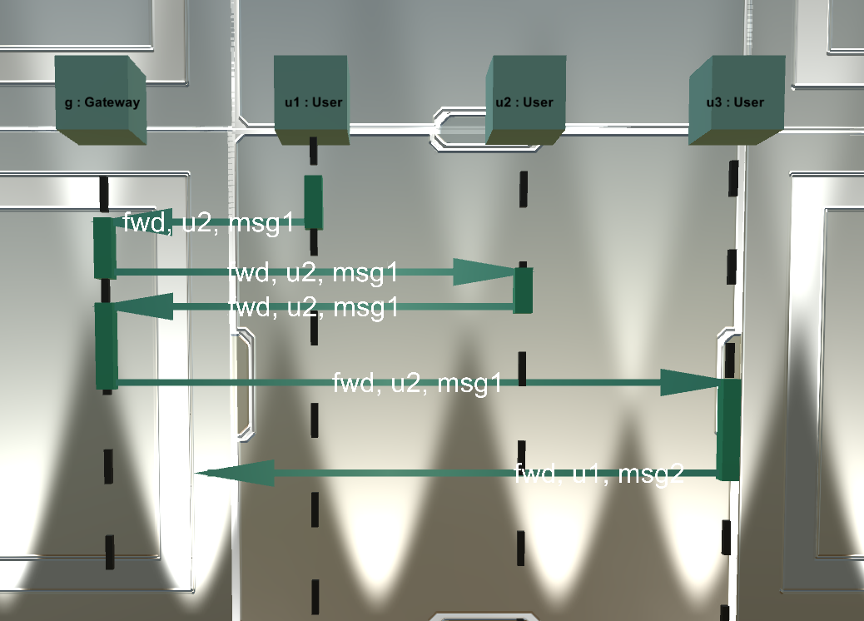
PROJECT
Main idea
Tool to visualize and simulate UML Diagrams in 3D
Kahoot-like group rooms
Instructor
Uploads/controls diagram
Student
Subscribes to group room

Slide 4
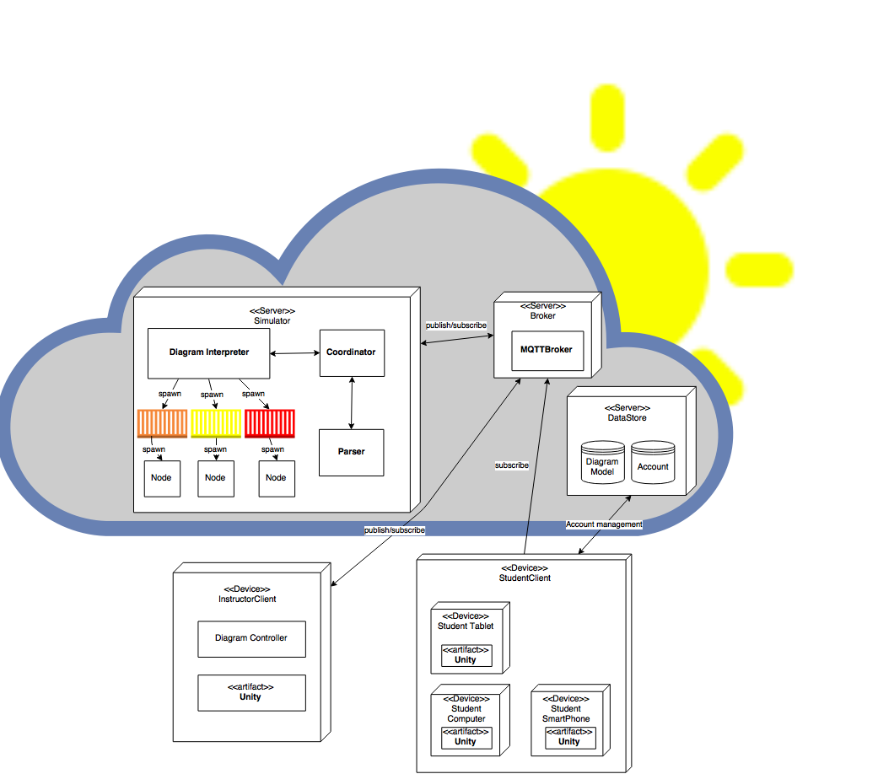
Planned Architecture
Deployment
Diagram

Slide 5
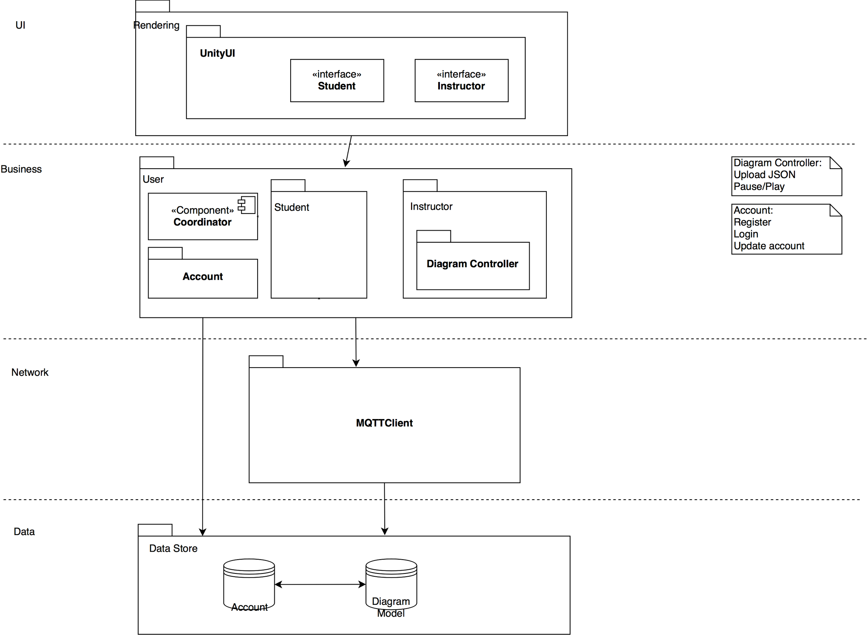
Planned Architecture
User
Component
Diagram

Slide 6
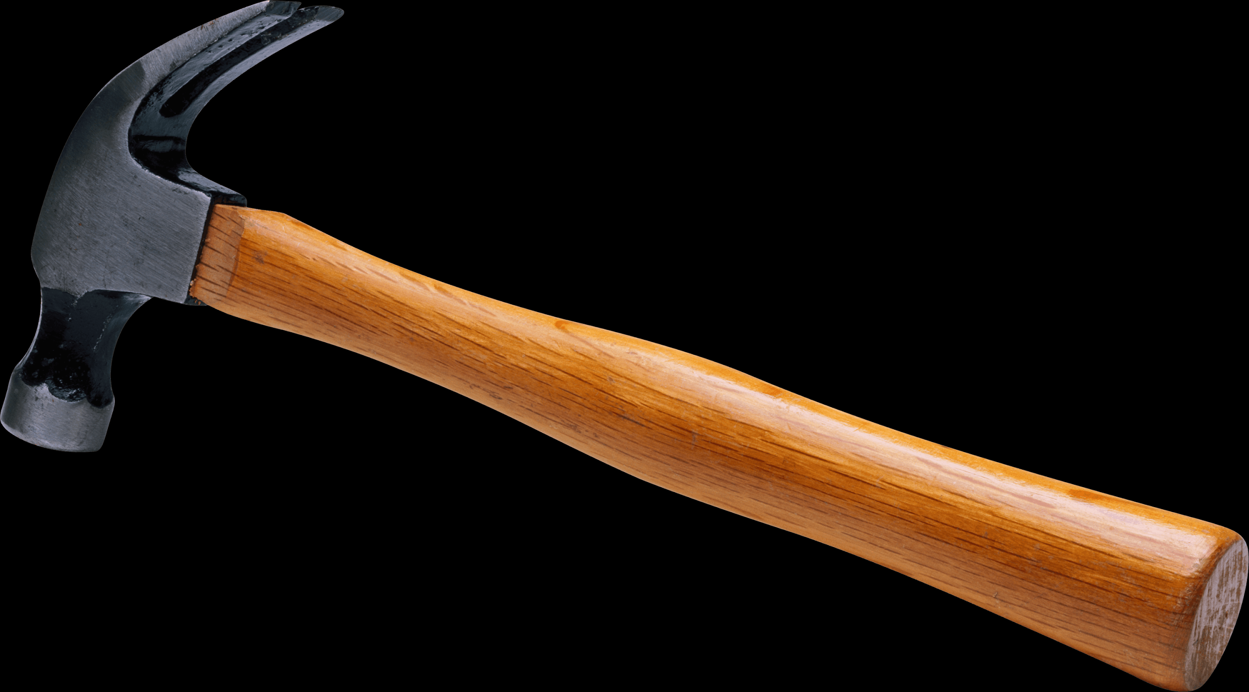
DEMO TIME!

